Slide 1
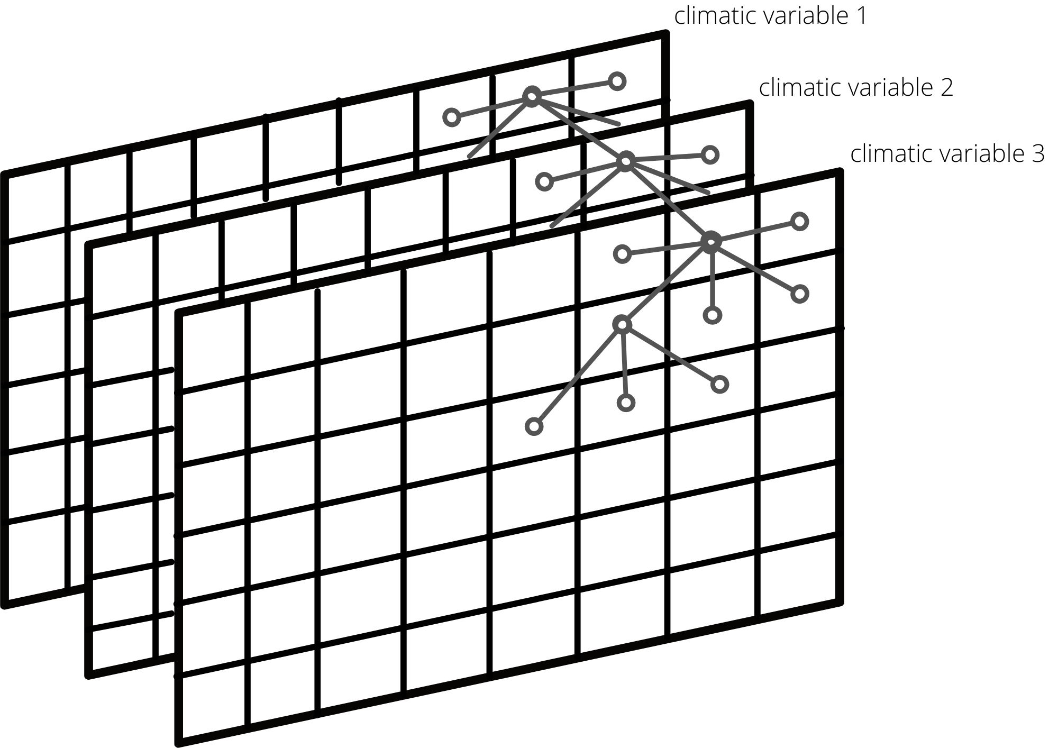
Hail risk predictions approaches
GNN + LSTM/GRU
GNN:
At every timestamp we have several geogrids of climatic variables. We need to map these tensors into embedding space. GNN is used to find connections between climatic variables and to create embeddings.
LSTM/GRU:
Since our data is time series, it is necessary to take into consideration its temporary structure. LSTM/GRU – networks are one of the main approaches to use with temporary data.
Considering the problem as classification problem we combine this approaches to predict hail events in future months.

